Slide 1
Partnering to Improve Veterans’ Health Care
Central Western Massachusetts VA Medical Center

Slide 2
Why have we asked for your time today?
“Honor America’s Veterans by providing exceptional health care that improves their health and well-being”
Notes:
Anticipating the return of many Veterans to our communities, many of whom will get care in the community as well as at their local VHA.
Acknowledge that VA hasn’t always done a good job collaborating with community physicians and hospitals.
We would like to open a conversation about how we can collaborate better to manage care for our shared Veteran patients.

Slide 3
Notes:
Most of the attention currently goes to those involved with wars in Iraq and Afghanistan, but VA treats Veterans of all ages and from all conflicts.

Slide 4
What Do We Hope to Accomplish Today?
Present basic information about the VA and how VHA health care works
Discuss ways we can collaborate better in taking care of Veterans
How to get VA medical records
How to transfer a Veteran from your hospital to VA
How does the VA medication system work?
Understanding your concerns and issues about collaborating with the VHA.

Slide 5
About the Department of Veterans Affairs
Established in 1930
Elevated to Cabinet level in 1989
Federal government’s second largest department after the Department of Defense
Three components:
Veterans Health Administration (VHA)
Veterans Benefits Administration (VBA)
National Cemetery Administration (NCA)
Notes:
Third leg on Federally Funded healthcare stool

Slide 6
What is the VHA?
VHA is an entitlement program funded by Congress which may change depending on the Department of Veteran Affairs budget
VHA is not an insurance policy for veterans

Slide 7
VETERANS HEALTH ADMINISTRATION - VHA
LARGEST INTEGRATED HEALTH CARE SYSTEM IN THE COUNTRY
153 Hospitals
956 Clinics (Hospital, Community-Based, Independent and Mobile)
134
Community Living Centers
232 Readjustment Counseling Centers
VET CENTERS
90 Domiciliary Resident Rehabilitation Treatment Programs
Notes:
7
Comment: Need to give explanation of what these things are…what is a Vet Center, etc.

Slide 8
Central Western MA VAMC
The Central Western MA VAMC has acute and chronic inpatient psychiatric services and a long term care unit.
Community Based Outpatient Clinics (CBOC)
Northampton, Springfield, Greenfield, Pittsfield, Worcester, Fitchburg
Currently have 22,600 Primary Care Patients

Slide 9
Central Western MA VAMC
Primary Care
Specialty clinics:
Cardiology Pulmonology
Optometry Audiology
Podiatry Rheumatology
Endocrinology Mental Health
Radiology/Cat Scan Physical Therapy
Nutrition Urology

Slide 10
Our Purpose: To Provide Excellent Patient-Centered Care for Veterans
Build understanding between community healthcare organizations and local VHA facility
Improve communication by identifying appropriate contacts at VHA and in the community
Safe transitions of care to reduce hospital readmissions
Moving from “dual management” to “co-management” systems

Slide 11
Starting point: Ask your patients…
Did they serve in the military?
If they have, are they enrolled in VHA?
If not, suggest they contact the VA at www.va.gov for veteran’s benefit information.
If they served in Iraq or Afghanistan, suggest they look at benefits information at http://www.oefoif.va.gov/index.asp

Slide 12
About VHA Primary Care
Patient Centered Medical Home model
Enrolled Veterans assigned to a Patient Aligned Care Team (PACT)
Primary Care Provider and the veteran’s PACT are the gateway to care and services at the VHA.

Slide 13
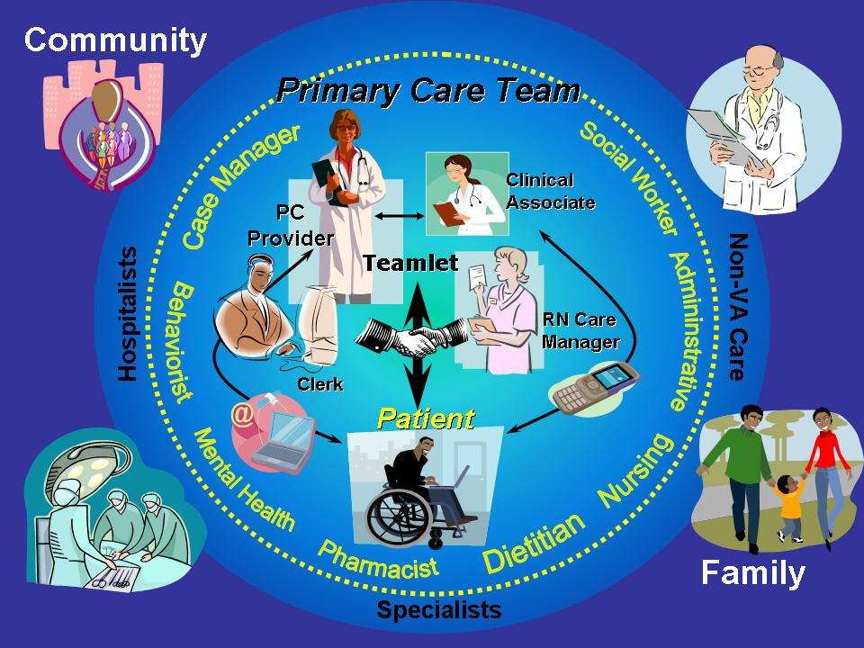
13

Slide 14
What do VHA Patients Pay for?
It varies:
If a healthcare problem was caused by the veteran’s military service, the VHA calls it “service connected” and the veteran receives free healthcare for that problem.
For other conditions, the VHA may charge a co-pay for healthcare visits, prescriptions, equipment or hospitalizations.
VHA bills Veterans’ commercial healthcare insurance for care unless it is service connected.
VHA does not bill Medicare.

Slide 15
Why is there Co-Managed Care?
Veterans enrolled in VHA care can use community healthcare services while maintaining their access to VHA benefits
50-70% of all enrolled Veterans are managed in partnerships with the private sector

Slide 16
Co-Management Challenges
Areas that are particularly challenging for community physicians when working with VA:
Getting medications and supplies
Getting patient information from VA
Transferring inpatients to the VA
What does the VA pay for at non-VA sites?
Notes:
Comments: There are different issues for outpatient providers vs. hospitalists/ED. Need 2 distinct presentations
Reinforce idea of the POC at VA (i.e. case manager) who can best address these issues in a timely and appropriate way

Slide 17
Medications and Equipment
VHA Pharmacy only fills prescriptions written by VHA providers or VHA fee-based providers.
Veterans get medications and medical equipment from VHA only for conditions managed by VHA providers
When Veteran’s ask their VHA provider to supply a medication prescribed by a community provider, the VHA provider reviews the clinical information available and/or schedules an appointment to see the Veteran because they will be medically responsible for the prescription
Notes:
stress VA is a health care system, not a pharmacy

Slide 18
VHA Providers use the VHA Formulary
The VHA Formulary:
http://www.pbm.va.gov/NationalFormulary.asp
Primary Care Providers prescribe medications within their scope of practice.
Medications prescribed by a community specialty care provider (ophthalmologist, oncologist, rheumatologist, etc.) require a VHA specialty care provider to concur and write.

Slide 19
Example: Preferred Medications
VA Formulary | Not on VA Formulary
Simvastatin (1st line) Pravastatin | Atorvastatin Rosuvastatin
Omeprazole Ranitidine Famotidine | Lansoprazole Esomeprazole
Finasteride | Dutasteride
Formoterol Mometasone | Advair

Slide 20
How Do I Contact VHA for Records?
Non-Urgent
Veteran can submit a Release of Information request to VHA to send information directly to the community provider
Request that the Veteran provide the information directly
Urgent
Mon-Fri 8:00 a.m. - 4:30 p.m.: Call appropriate CBOC and connect to patient’s PACT team
Evenings, nights, weekends, holidays: Call CWM VA @ 413 584 4040 X 2461 and ask for administrator on duty
My Health e Vet option
Veteran prints information , secure messages the VHA provider to call, or can grant access to EMR

Slide 21
Central Western MA VAMC
Central Western Mass VA 413 584 4040
Northampton: X1037
Springfield: X6026
Greenfield: X6430
Pittsfield: X6301
Worcester: X17900
Fitchburg: X6200
After hours: 413 584 4040 X 2461

Slide 22
Notes:
Print is too small but may be useful as way to talk briefly about MHV

Slide 23
How Do I Transfer a Veteran Patient to the VA?
Monday–Friday
Emergent: 911 Send to ER
Non-emergent: Contact Urgent Care Northampton: 413 584 4040 X 1037 inform Administer of the Day (AOD) Patient is being be sent to Urgent Care; instruct if Medical vs. Mental Health
Notes:
Business hours ( Monday-Friday 8am-4:30 pm) vs. after hours for admissions:
During regular business hours: if Emergent-call 911 for an ambulance to transport to the nearest ER
2. If non-emergent-call “urgent care” x1037 and inform the AOD(administrator of the Day) that a patient is coming. The AOD will then inform triage.
3. If mental health issues, call the AOD to inform them a patient is coming .The AOD will inform the mental health team in urgent care where the patient will be triaged. Any patient sent for mental health concerns should be medically cleared and the POD and the AOD need to be sure we can meet the patient’s care needs and we have an available bed.
4. Inform family/significant others that the Veteran is being sent to the Northampton site for evaluation.
After regular business hours, weekends and holidays:
If emergent-call 911 and send to local ER.
If non-emergent-send patient to “urgent” care at Northampton site for evaluation by the MOD(Medical Officer of the Day). Call extension 2461 to inform the AOD that a patient is being sent for evaluation(this is if the patient is coming from home or the community with a non-emergent issue.
3. If a mental health issue-the MOD will contact the POD(Psychiatrist of the Day) for evaluation and consultation. If the patient needs admission to the psychiatric unit, admission is approved by the POD and the MOD if the POD is not on duty or on station.If medical issues,the Urgent care medical doctor needs to approve.

Slide 24
How Do I Transfer a Veteran Patient to the VA?
After hours/Weekends/Holidays
Emergent: 911 Send to ER
Non-Emergent: Call AOD Urgent Care 413 584 4040 X 2461
Inform Patient is being sent to Urgent Care, instruct if Medical vs. Mental health
Notes:
If non-emergent-call “urgent care” x1037 and inform the AOD(administrator of the Day) that a patient is coming. The AOD will then inform triage.
If mental health issues, call the AOD to inform them a patient is coming .The AOD will inform the mental health team in urgent care where the patient will be triaged. Any patient sent for mental health concerns should be medically cleared and the POD and the AOD need to be sure we can meet the patient’s care needs and we have an available bed.

Slide 25
What will VHA pay for at non-VHA sites?
It varies and it is complicated.
If VA services are available, VA usually does not pay
If VA services not available, then there are circumstances where VA may pay
Managed by Fee Basis department
Millenium Bill
Contact : Mill Bill/Fee Services: 1 413 584 4040 X 2919

Slide 26
For More In-Depth Information: The 3-Hour Workshop
Learn more about the services available to eligible Veteran patients
Explore specific processes for accessing VA services, prescriptions, equipment & supplies, hospital discharge, transfers, and more
Discuss challenges faced by providers, case managers, nurses and other team members involved in co-managed care

Slide 27
Clinical Pearls
Ask “Are you a Veteran?”
Acknowledge military service
Ask about VHA PACT Team contact information, if VHA used
Encourage Veteran to use MyHealtheVet
Take a military history
Branch / Rank / Dates / Deployments / Job
Combat exposures
Illness / injuries while deployed

Slide 28
Resources for Health Professionals
VA / DoD Clinical Practice Guidelines
http://www.healthquality.va.gov
http://www.nationalresourcedirectory.gov/
http://www.pdhealth.mil/hcc/sapr.asp
http://www.womenshealth.va.gov/
Notes:
VEHU Classes?
Clinical Training available to community?

Slide 29
How to Contact Us
If you have any questions, please contact:
Resource telephone numbers listed for Primary Care Clinics
Notes:
Comment “When in doubt, call the case manager”

Slide 30
Questions & Answers
Notes:
Comment: Say, “we may not know all the answers but we will point you in the right direction”

